Slide 1
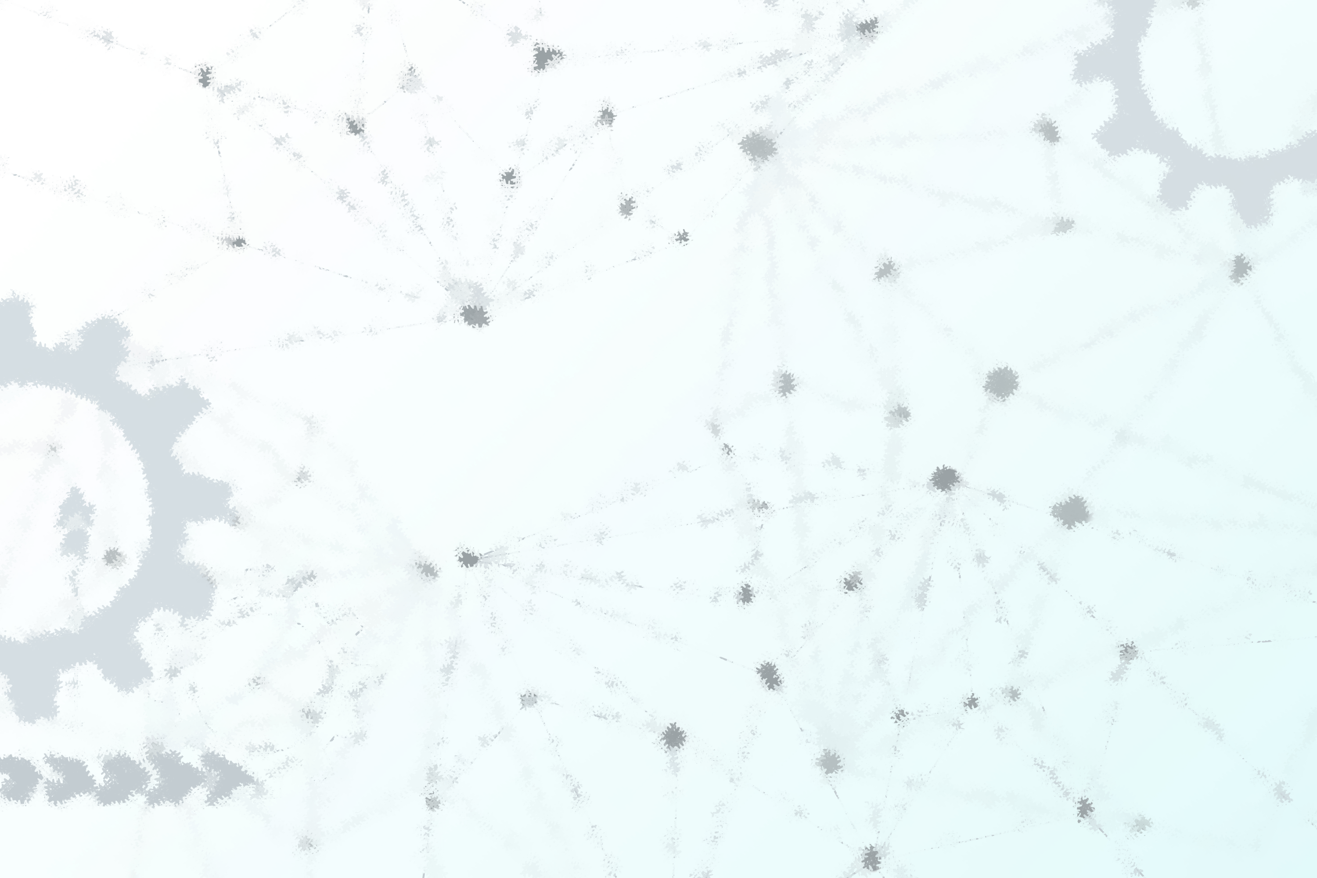

Comparative Analysis of Machine Learning Models for Parkinson’s Disease Detection
ST228 (Mini Project)
Priyanshi Dubey | 24093
Shivam Rathour | 24110

Slide 2



Problem Statement
Classify individuals as healthy or Parkinson’s Disease based on voice measurements using multiple models.
Target Variable: STATUS
$$0=Healthy$$
$$1=Parkinson^{′}s$$

Slide 3
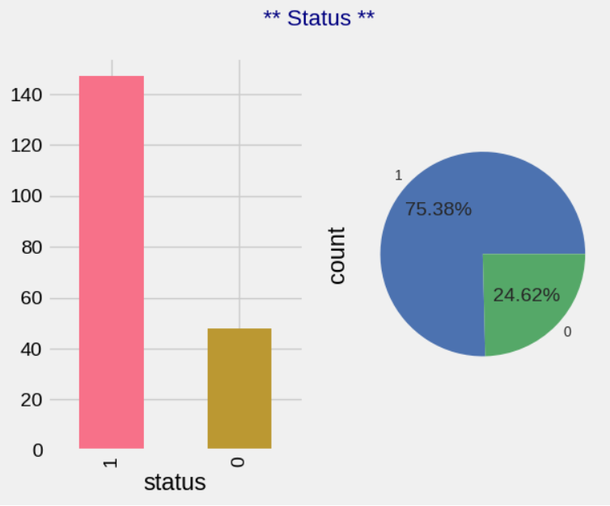
Data Overview
Dataset includes various voice metrics (e.g., Jitter, Shimmer, HNR, RPDE, DFA, etc).
Total 195 samples and 23 features.
Class imbalance: More PD patients than healthy
No missing values in any feature.
Mean, standard deviation, maximum value, minimum value, data type, etc. are determined for the datapoints under each feature.
Percentage of healthy and Parkinson’s patients is calculated.

Slide 4
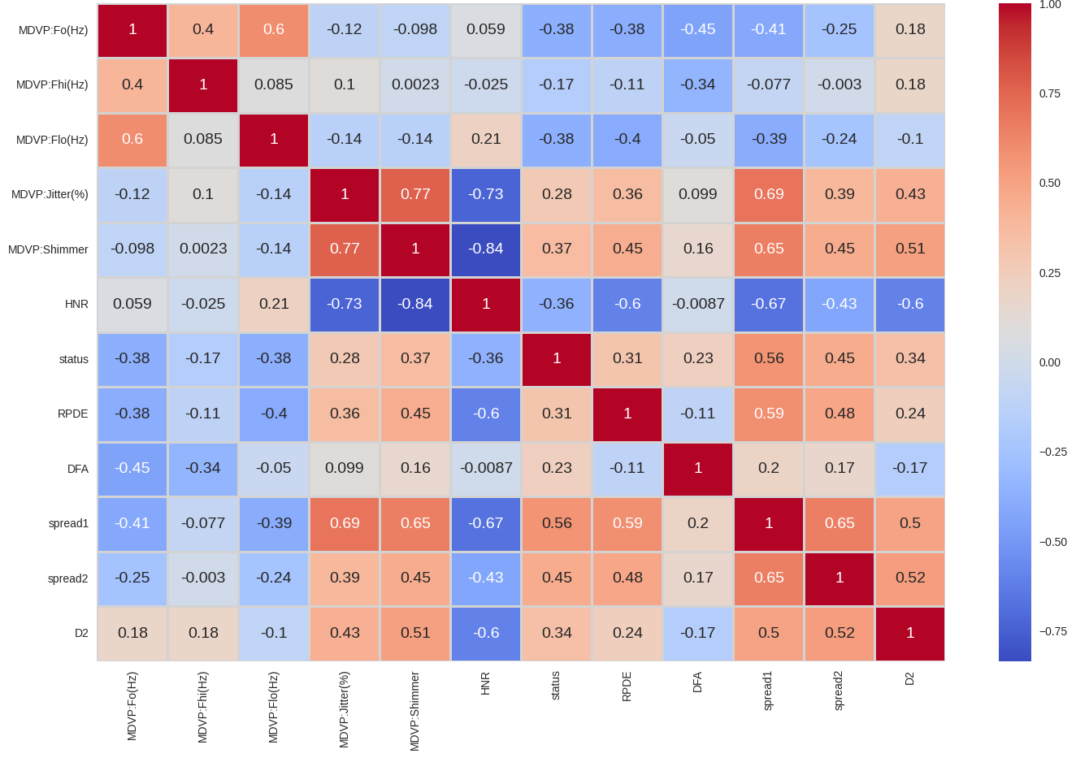
Dimensionality Reduction
Highly correlated features are removed from the dataset.
Now we have only 12 features in the dataset.

Slide 5
Models used
Logistic Regression: Simple, interpretable baseline.
K-Nearest Neighbors: Good for small datasets.
Decision Tree: Handles non-linearity.
Random Forest: Reduces overfitting.
AdaBoost: sequentially trains models, each correcting the previous
XGBoost: Powerful ensemble method and faster version of Gradient Boosting.

Slide 6
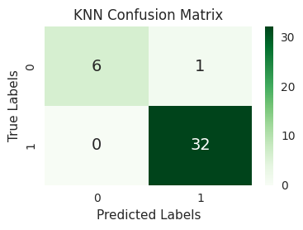
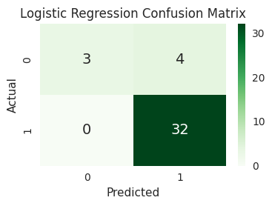
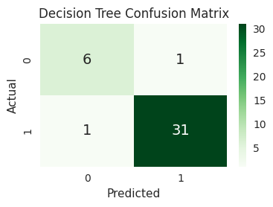
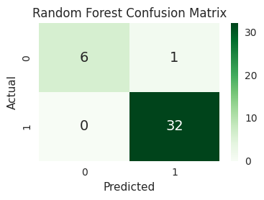
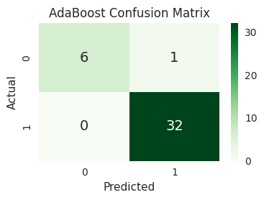
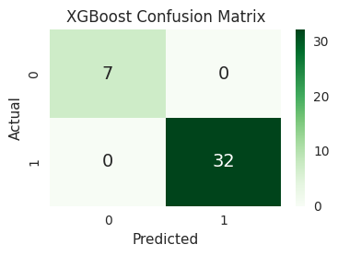
Confusion Matrix for Each Model

Slide 7
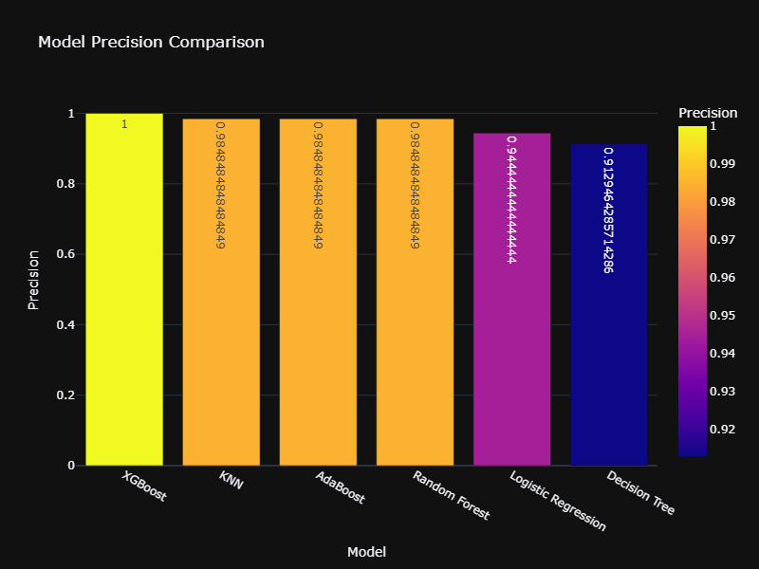
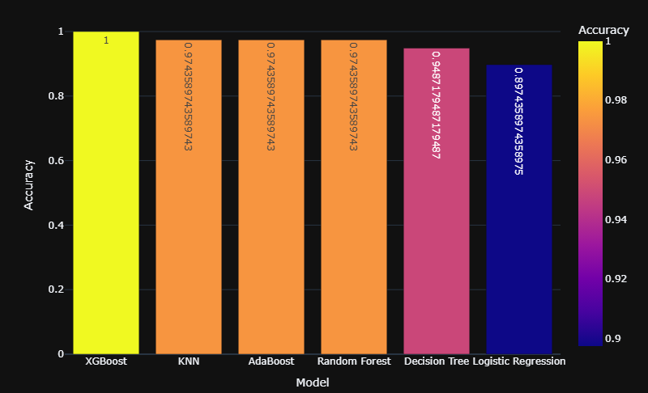
Model Comparison
Accuracy score
Precision score

Slide 8
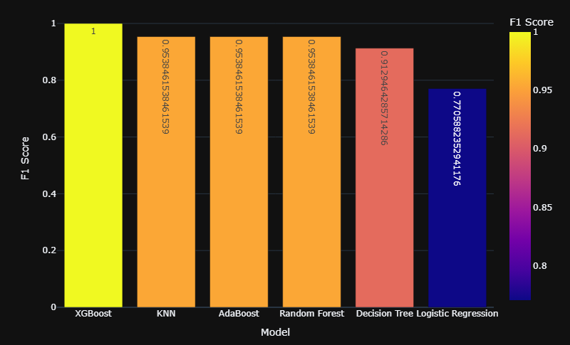
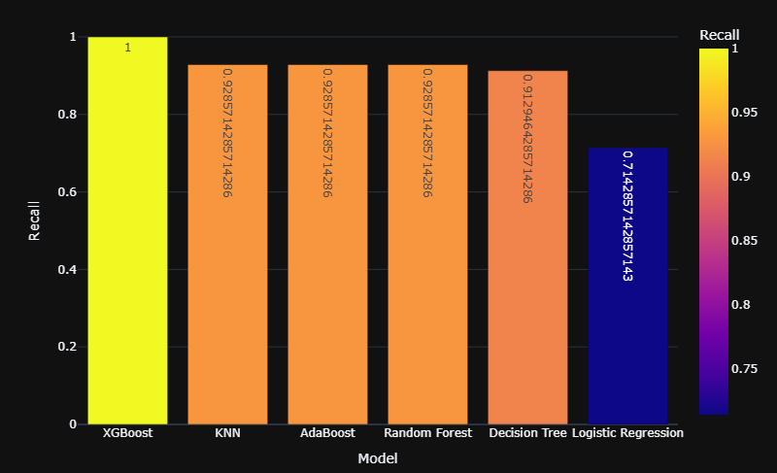
Model Comparison
Recall Score
F1 Score

Slide 9
ML Models’ Performance Summary
 | Accuracy | Precision | Recall Score | F1 Score | REMARKS
XGBoost | 1.0000 | 1.0000 | 1.0000 | 1.0000 | No errors. Likely the best model but there may be a possibility of overfitting.
Random Forest | 0.9744 | 0.9560 | 0.9286 | 0.9848 | Excellent overall – High precision and recall.
AdaBoost | 0.9744 | 0.9560 | 0.9286 | 0.9848 | Performs equally well as Random Forest.
KNN | 0.9744 | 0.9560 | 0.9286 | 0.9848 | Similar to Random Forest and AdaBoost in this case.
Decision Tree | 0.9487 | 0.9128 | 0.9129 | 0.9129 | Very good recall – good if catching positives is critical.
Logistic Regression | 0.8974 | 0.8100 | 0.7143 | 0.9444 | Weakest performer – high precision but poor recall. Not recommended alone.

Slide 10
Conclusion
XGBoost is the top performer. It made zero errors in classification, indicating outstanding capability though it's essential to validate it further to ensure no overfitting.
Random Forest, AdaBoost, and KNN show consistently strong performance (97%+ accuracy) with excellent precision and recall. These models balance precision and recall well, making them reliable for general use without extreme complexity.
The Decision Tree model, though less accurate overall, its recall is competitive, which matters in sensitive cases like medical diagnosis.
Logistic Regression underperforms relative to the others making it unsuitable unless simplicity is the priority.

Slide 11
Thank You!

